Slide 1
CSC 735 – Data Analytics
Chapter 7
Aggregations – Window Functions

Slide 2
Working with Date-Time Functions
Spark built-in date-time functions fall into the three categories:
converting from one format to another
performing date-time calculations
extracting parts from a date or timestamp

Slide 3
Date-Time Conversion Functions
The default date format is yyyy-MM-dd HH:mm:ss
If the date format of a date-timestamp column is different, you need to provide that pattern to the conversion function

Slide 4
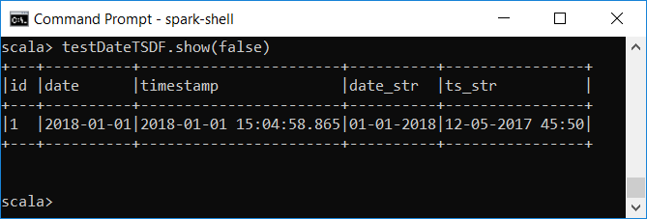
Example
Converting a date and timestamp in string type to Spark Date and Timestamp type
val testDateTSDF = Seq((1, "2018-01-01", "2018-01-01 15:04:58.865",
"01-01-2018", "12-05-2017 45:50")) .toDF("id", "date", "timestamp","date_str", "ts_str")
testDateTSDF.show(false)

Slide 5
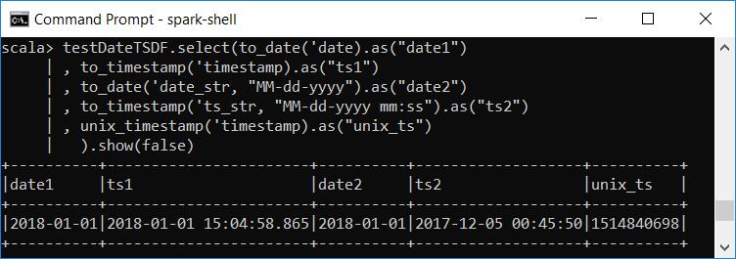
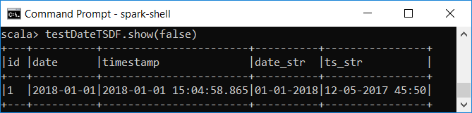
Example (cont.)
testDateTSDF.select(to_date('date).as("date1")
, to_timestamp('timestamp).as("ts1")
, to_date('date_str, "MM-dd-yyyy").as("date2")
, to_timestamp('ts_str, "MM-dd-yyyy mm:ss").as("ts2")
, unix_timestamp('timestamp).as("unix_ts")
).show(false)

Slide 6
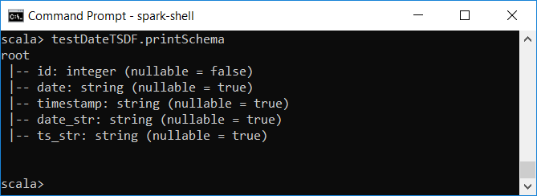
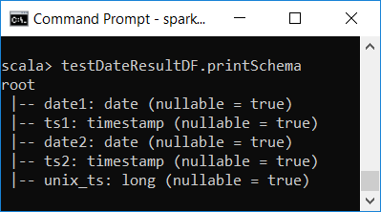
Example (cont.)
val testDateResultDF = testDateTSDF.select(to_date('date).as("date1")
, to_timestamp('timestamp).as("ts1")
, to_date('date_str, "MM-dd-yyyy").as("date2")
, to_timestamp('ts_str, "MM-dd-yyyy mm:ss").as("ts2")
, unix_timestamp('timestamp).as("unix_ts"))
testDateResultDF.printSchema

Slide 7
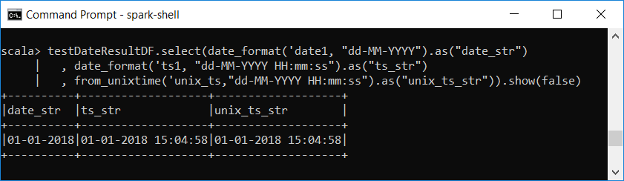
Converting Date-Time to String
Use the date_format function convert a date-timestamp to a string by using with a custom date format
Use the from_unixtime function to convert a Unix timestamp (in seconds) to a string
testDateResultDF.select(date_format('date1, "dd-MM-YYYY").as("date_str")
, date_format('ts1, "dd-MM-YYYY HH:mm:ss").as("ts_str")
, from_unixtime('unix_ts,"dd-MM-YYYY HH:mm:ss").as("unix_ts_str")).show

Slide 8
Window Functions
Read https://www.postgresql.org/docs/current/static/tutorial-window.html
Window functions are used to compute some aggregation on a specific "window" of data
Use cases include calculating a moving average, a cumulative sum, and the rank of each row
The window specification determines which rows are used by the window function

Slide 9
Window Functions
There are two main steps for working with window functions
The first one is to define a window specification that defines a logical grouping of rows
The second step is to apply a window function as needed

Slide 10
Window Specification
import org.apache.spark.sql.expressions.Window
The window specification involves three parts:
partition by: where you specify one or more columns to group the rows by
order by: defines how the rows should be ordered based on one or more columns
frame: it defines the boundary of the window with respect to the current row - The frame restricts which rows to be included when calculating a value for the current row

Slide 11
"Window" Frames
A range of rows to include in a window frame can be specified using the row index or the actual value of the order by expression
The rowsBetween and rangeBetweeen functions are used to define the range by row index and actual value, respectively

Slide 12
Window Functions
Spark supports three kinds of window functions:
ranking functions
analytic functions
aggregate functions

Slide 13
Ranking Functions
Name | Description
rank | Returns the rank or order of rows within a frame based on some sorting order.
dense_rank | Similar to rank, but leaves no gaps in the ranks when there are ties.
percent_rank | Returns the relative rank of rows within a frame.
ntile(n) | Returns the ntile group ID in an ordered window partition. For example, if n is 4, the first quarter of the rows will get a value of 1, the second quarter of rows will get a value of 2, and so on.
row_number | Returns a sequential number starting with 1 within a frame

Slide 14
Analytic Functions
Name | Description
cume_dist | Returns the cumulative distribution of values with a frame. In other words, the fraction of rows that are below the current row
lag(col, offset) | Returns the value of the column that is offset rows before the current row.
lead(col, offset) | Returns the value of the column that is offset rows after the current row

Slide 15
Grouping Functions
We can use any aggregation functions as a window function

Slide 16
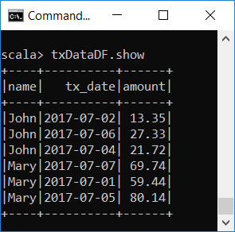

The Dataset
The Dataset contains shopping transaction data of two fictitious users, John and Mary
import org.apache.spark.sql.expressions.Window
val txDataDF = Seq(
("John", "2017-07-02", 13.35), ("John", "2017-07-06", 27.33),
("John", "2017-07-04", 21.72), ("Mary", "2017-07-07", 69.74),
("Mary", "2017-07-01", 59.44), ("Mary", "2017-07-05", 80.14)
).toDF("name", "tx_date", "amount")
txData $≡$ transaction Data

Slide 17
Data Analysis Tasks
With this shopping transaction data, use window functions to answer the following questions:
For each user, what are the two highest transaction amounts?
What is the difference between the transaction amount of each user and their highest transaction amount?
What is the moving average transaction amount of each user?
What is the cumulative sum of the transaction amount of each user?

Slide 18
1. For each user, what are the two highest transaction amounts?
Idea: Apply the rank window function over a window specification that partitions the data by user and sorts it by the amount in descending order
The rank function assigns a rank to each row based on the sorting order of each row in each frame
import org.apache.spark.sql.expressions.Window
val windowSpec = Window.partitionBy("name") .orderBy(col("amount").desc)
txDataDF.withColumn("rank", rank().over(windowSpec)) .where('rank < 3).show

Slide 19
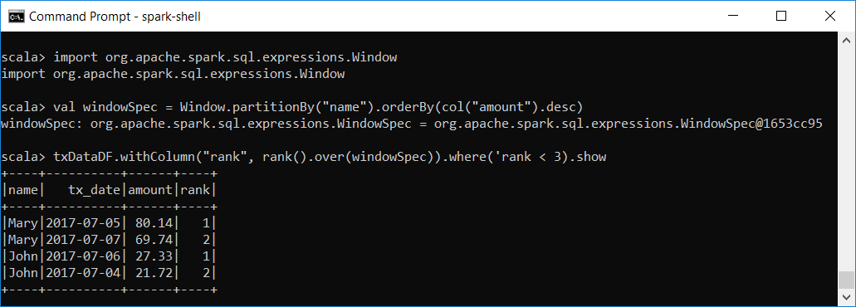
1. For each user, what are the two highest transaction amounts?
import org.apache.spark.sql.expressions.Window
val windowSpec = Window.partitionBy("name") .orderBy(col("amount").desc)
txDataDF.withColumn("rank", rank().over(windowSpec)) .where('rank < 3).show

Slide 20
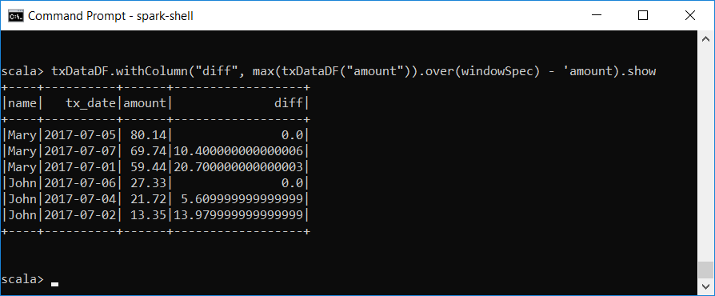
2. Find is the difference between the transaction amount of each user and their highest transaction amount?
Idea: max(col(amount)) finds the max transaction amount for each person. Subtract from current tx amount
txDataDF.withColumn("diff",
max(txDataDF("amount")).over(windowSpec) - 'amount).show

Slide 21
3. What is the moving average transaction amount of each user?
Assumption: the moving average is over a window Frame of three rows, starting with the row before the current row and ending with the row after the current row. We order by tx_date as this is time series data.
val windowSpec2 = Window.partitionBy("name") .orderBy("tx_date") .rowsBetween(Window.currentRow - 1, Window.currentRow + 1)
txDataDF.withColumn("moving_Average", avg(txDataDF("amount")).over(windowSpec2)).show

Slide 22
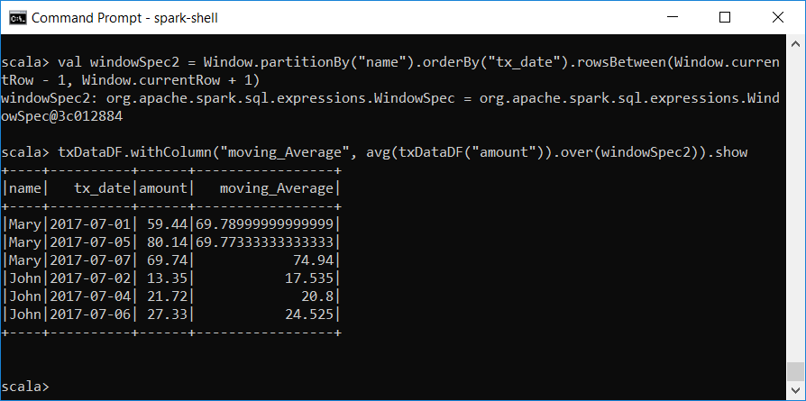
3. What is the moving average transaction amount of each user?

Slide 23
4. What is the cumulative sum of the transaction amount of each user?
Idea: apply the sum function over a frame that consists of all the rows up to the current row
val windowSpec3 = Window.partitionBy("name").orderBy("tx_date") .rowsBetween(Window.unboundedPreceding, Window.currentRow)
txDataDF.withColumn("cumulative_sum", sum(txDataDF("amount")).over(windowSpec3)).show

Slide 24
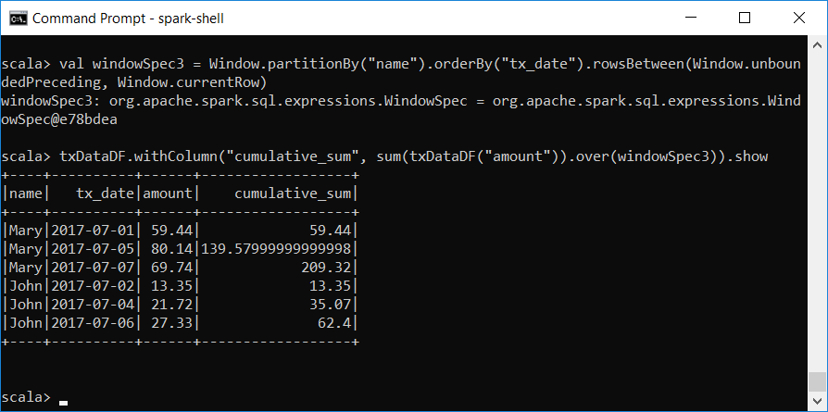
4. What is the cumulative sum of the transaction amount of each user?
val windowSpec3 = Window.partitionBy("name").orderBy("tx_date") .rowsBetween(Window.unboundedPreceding, Window.currentRow)
txDataDF.withColumn("cumulative_sum", sum(txDataDF("amount")).over(windowSpec3)).show

